Slide 1
Variance
Variance = How far are data points from their mean?
High variance = Data is more scattered from its mean
Low variance = Data is less scattered from mean
Variance calculation:
Find the mean of the given data set
Subtract the mean from each value and square the result
The average of these squared values is the variance

Slide 2
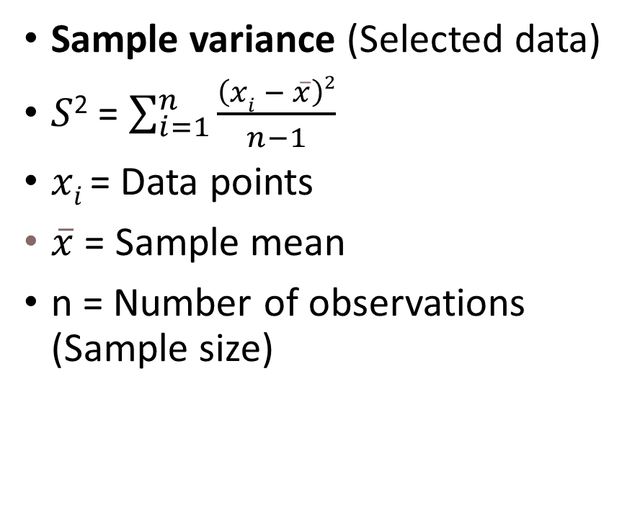
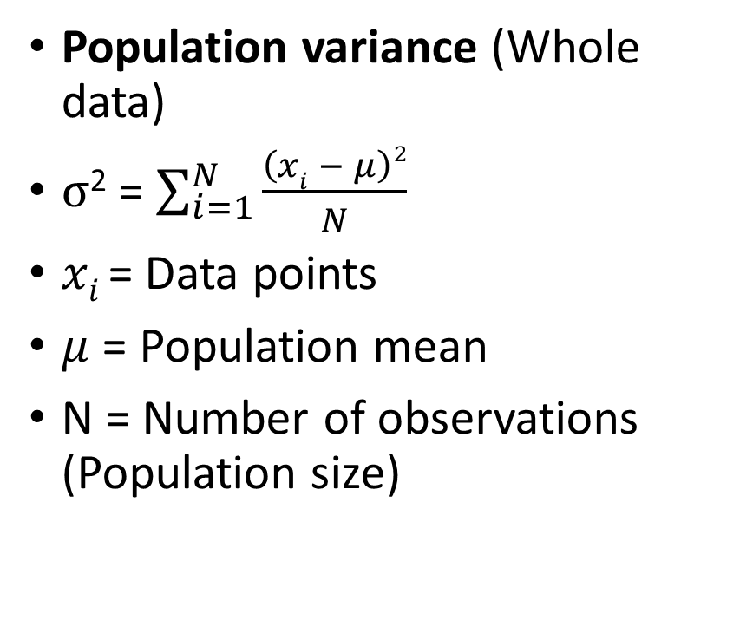
Variance Formula
Population variance (Whole data)
$σ$² = $\sum_{i=1}^{N}{\frac{\left(xi − μ\right)2}{N}}$
$xi$= Data points
$μ$ = Population mean
N = Number of observations (Population size)
Sample variance (Selected data)
$S$² = $\sum_{i=1}^{n}{\frac{\left(xi − \overline{x}\right)2}{n−1}}$
$xi$= Data points
$\overline{x}$ = Sample mean
n = Number of observations (Sample size)

Slide 3
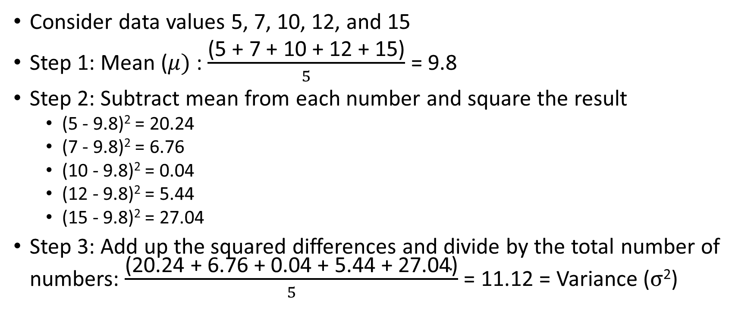
Variance Example
Consider data values 5, 7, 10, 12, and 15
Step 1: Mean ($μ)$: $\frac{\text{(5 + 7 + 10 + 12 + 15)}}{5}$ = 9.8
Step 2: Subtract mean from each number and square the result
(5 - 9.8)² = 20.24
(7 - 9.8)² = 6.76
(10 - 9.8)² = 0.04
(12 - 9.8)² = 5.44
(15 - 9.8)² = 27.04
Step 3: Add up the squared differences and divide by the total number of numbers: $\frac{\text{(20.24 + 6.76 + 0.04 + 5.44 + 27.04)}}{5}$ = 11.12 = Variance ($σ$²)

Slide 4
Why are the Differences Squared?
If we do not do this, then the positive and negative differences may cancel each other and we may not be able to find how the data points are dispersed from the mean
Example: Consider marks of 5 students: 55, 60, 65, 54, 64
Mean: 59.6, Variance: 20.24
But if we do not square the differences, what will happen?
Marks | Marks - Mean | (Marks - Mean) Squared
55 | -4.6 | 21.16
60 | 0.4 | 0.16
65 | 5.4 | 29.16
54 | -5.6 | 31.36
64 | 4.4 | 19.36
Mean | (Marks - Mean) / 5 | ((Marks - Mean) Squared)) / 5
59.6 | 0.00 | 20.24
Variance

Slide 5
Limitation of Variance: How to Quantify?
Quantifying/measuring variance is tough
Example: Consider marks of 10 students: 32, 39, 44, 56, 56, 63, 71, 72, 81, 89
Mean: 60.3, Variance: 306.81
Variance seems to be high, but it does not convey any meaningful information beyond this
This is a limitation of variance

Slide 6
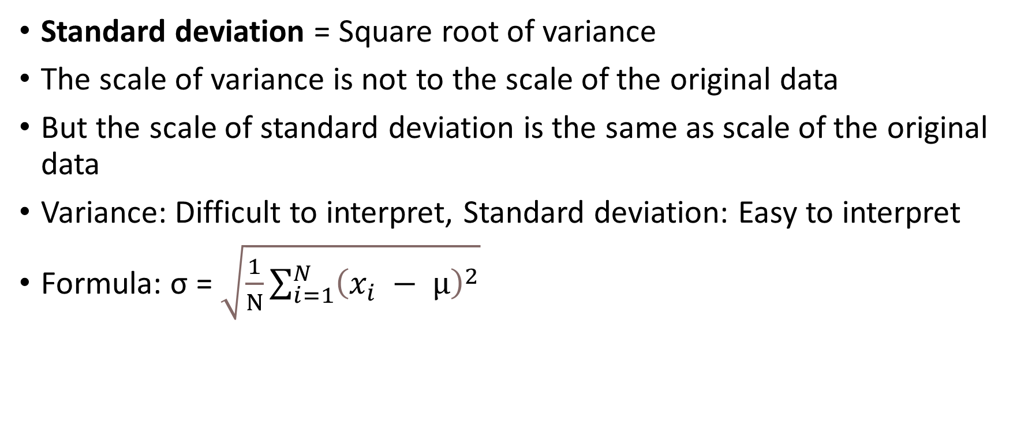
Standard Deviation
Standard deviation = Square root of variance
The scale of variance is not to the scale of the original data
But the scale of standard deviation is the same as scale of the original data
Variance: Difficult to interpret, Standard deviation: Easy to interpret
Formula: σ = $\sqrt{\frac{1}{N}\sum_{i=1}^{N}{{\left(x_{i} − μ\right)}^{2}}}$

Slide 7

Standard Deviation Example
Marks of 10 students: 76, 89, 53, 75, 80, 67, 61, 59, 71, 60
Mean ($μ$): $\frac{\text{76 + 89 + 53 + 75 + 80 + 67 + 61 + 59 + 71 + 60}}{ 10}$ = $\frac{691}{10}$ = 69.10
Standard deviation (σ) = $\sqrt{111.49}$ = 10.56
Deviation | Deviation Squared
76 – 69.10 = 6.9 | 47.61
89 – 69.10 = 19.9 | 396.01
53 – 69.10 = -16.1 | 259.21
75 – 69.10 = 5.9 | 34.81
80 – 69.10 = 10.9 | 118.81
67 – 69.10 = -2.1 | 4.41
61 – 69.10 = -8.1 | 65.61
59 – 69.10 = -10.1 | 102.01
71 – 69.10 = 1.9 | 3.61
60 – 69.10 = -9.1 | 82.81
Total: | 1114.90
Variance (σ²) = | 1114.90 / 10 = 111.49

Slide 8
Exercise
Interpret the data below
Group A and Group B are two groups of people and we have data about their blood sugar level
A = 125, 118, 121, 123, 119, 122, 117, 121, 124, 116, 120, 122, 119, 124, 118, 120, 123, 122, 118, 121
B = 150, 90, 115, 145, 118, 112, 135, 121, 117, 122, 119, 128, 115, 145, 120, 90, 155, 135, 122, 115

Slide 9
Standard Deviation: True Indicator of Homogeneous/Heterogeneous Data
Consider cholesterol levels of two groups of people:
A = 125, 118, 121, 123, 119, 122, 117, 121, 124, 116, 120, 122, 119, 124, 118, 120, 123, 122, 118, 121
Mean = 120 mg/dL, SD = 5 mg/dL
Most close to the mean (Fit)
B = 150, 90, 115, 145, 118, 112, 135, 121, 117, 122, 119, 128, 115, 145, 120, 90, 155, 135, 122, 115
Mean = 120 mg/dL, SD = 30 mg/dL
Some close to the mean (Fit), some away from the mean (Unfit)

Slide 10
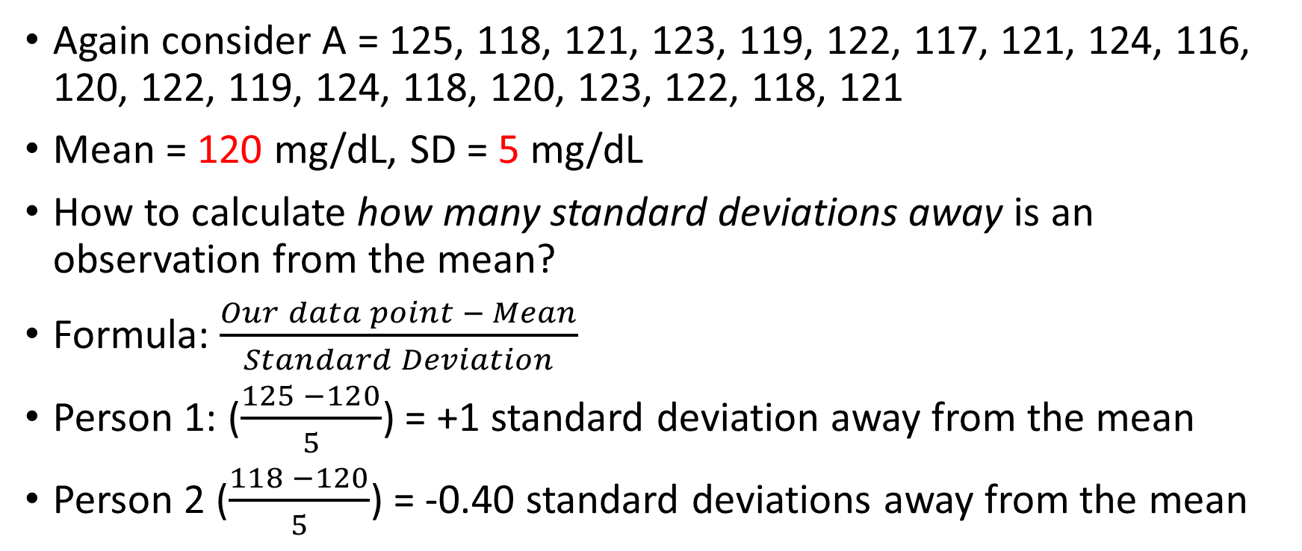
Interpreting Standard Deviation
Again consider A = 125, 118, 121, 123, 119, 122, 117, 121, 124, 116, 120, 122, 119, 124, 118, 120, 123, 122, 118, 121
Mean = 120 mg/dL, SD = 5 mg/dL
How to calculate how many standard deviations away is an observation from the mean?
Formula: $\frac{Our data point − Mean}{Standard Deviation}$
Person 1: ($\frac{125 −120}{5}$) = +1 standard deviation away from the mean
Person 2 ($\frac{118 −120}{5}$) = -0.40 standard deviations away from the mean

Slide 11
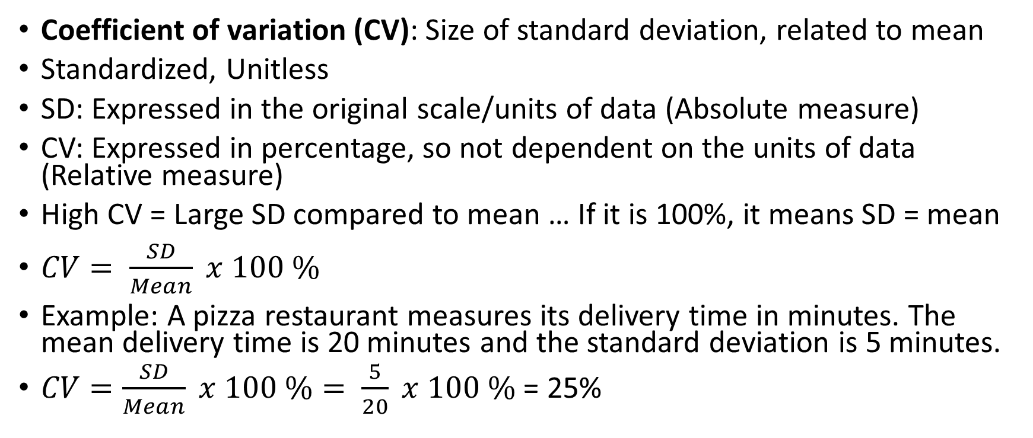
Coefficient of Variation (CV)
Coefficient of variation (CV): Size of standard deviation, related to mean
Standardized, Unitless
SD: Expressed in the original scale/units of data (Absolute measure)
CV: Expressed in percentage, so not dependent on the units of data (Relative measure)
High CV = Large SD compared to mean … If it is 100%, it means SD = mean
$CV= \frac{SD}{Mean} x 100 \%$
Example: A pizza restaurant measures its delivery time in minutes. The mean delivery time is 20 minutes and the standard deviation is 5 minutes.
$CV=\frac{SD}{Mean} x 100 \%= \frac{5}{20} x 100 \%$ = 25%

Slide 12
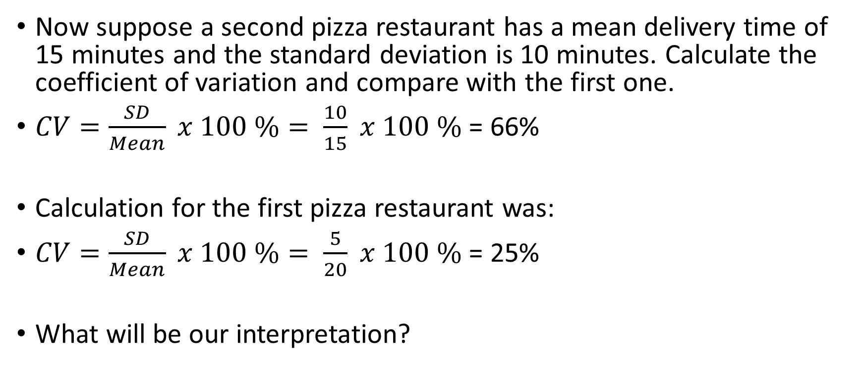
Coefficient of Variation (CV)
Now suppose a second pizza restaurant has a mean delivery time of 15 minutes and the standard deviation is 10 minutes. Calculate the coefficient of variation and compare with the first one.
$CV=\frac{SD}{Mean} x 100 \%= \frac{10}{15} x 100 \%$ = 66%
Calculation for the first pizza restaurant was:
$CV=\frac{SD}{Mean} x 100 \%= \frac{5}{20} x 100 \%$ = 25%
What will be our interpretation?

Slide 13
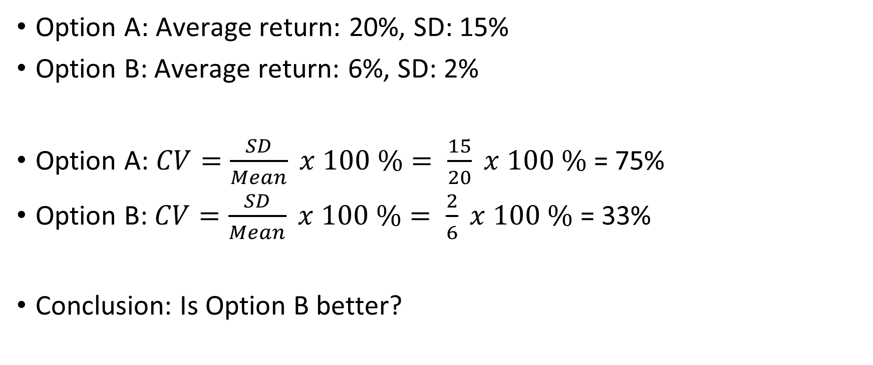
Making Investment Decisions
Option A: Average return: 20%, SD: 15%
Option B: Average return: 6%, SD: 2%
Option A: $CV=\frac{SD}{Mean} x 100 \%= \frac{15}{20} x 100 \%$ = 75%
Option B: $CV=\frac{SD}{Mean} x 100 \%= \frac{2}{6} x 100 \%$ = 33%
Conclusion: Is Option B better?

Slide 14
Exercise: Calculate CV
Consider equivalent temperatures
Fahrenheit | Celsius
41 | 5.00
46 | 7.88
52 | 11.11
57 | 13.89
59 | 15.00
60 | 15.56
62 | 16.67

Slide 15
Solution: Calculate CV
Consider equivalent temperatures
Fahrenheit | Celsius
41 | 5.00
46 | 7.88
52 | 11.11
57 | 13.89
59 | 15.00
60 | 15.56
62 | 16.67
SD = 7.28 | SD = 4.04
Mean = 53.86 | Mean = 12.14
CV = 13.51% | CV = 33.30%
For equal temperatures, how can CV be different?
Answer: Temperatures use interval scale
Ideally, we should use CV only for ratio scale (variables that have an absolute zero)

Slide 16
Skewness

Slide 17
Skewness can be Confusing!
Skew: Represents the asymmetry of a distribution around its mean
Skew = Where is the skew, not where is the data
Students appearing in an Examination
No-skew: Student marks are evenly distributed
Right-skew: Most students get low marks => Long tail to the right (higher values)
Left-skew: Most students get high marks => Long tail to the left (lower values)
Skew | Tail | Most Data | Interpretation
Right (Positive) | On the Right | On the Left | Most values are low
Left (Negative) | On the Left | On the Right | Most values are high

Slide 18
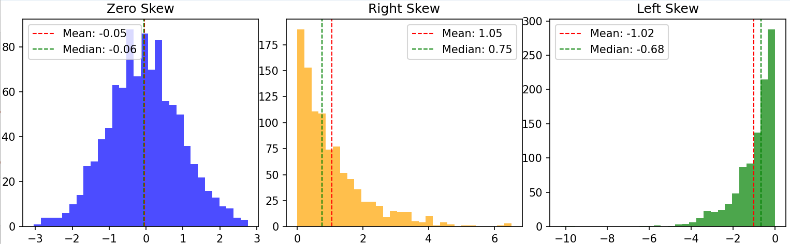
Skew
C:\code\Data Analytics\skew-visualize.py
Zero-skew (No-skew): Mean = Median
Characteristic | Right (Positive) Skew | Left (Negative) Skew
Key feature | Most values are on the lower side, a few on are the higher side | Most values are on the higher side, a few are on the lower side
Statistics | Mean > Median | Mean < Median
Mean | Skewed to the right | Skewed to the left
Tail | Comes later - On the right (Represents high values) | Comes first - On the left (Represents low values)
More data points | On the left | On the right
Outliers | On the right | On the left
Ratings Example | Most people give ratings of 1 or 2 out of 5 | Most people give ratings of 4 or 5 out of 5
Example | Incomes of people | Ages at the time of death
Why? | Most people have low incomes, Very few have very high income | Most people would die in older age, Very few children die

Slide 19
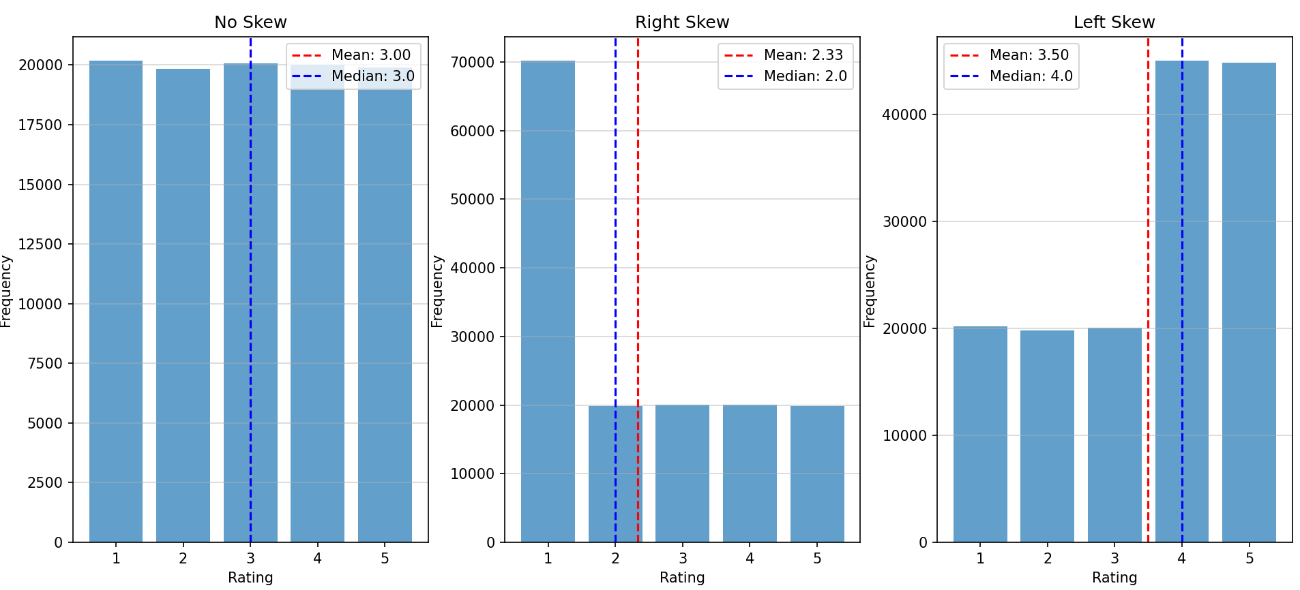
Simple Ratings Example (C:\code\Data Analytics\Skew-dummy.py)
Consider 1 lakh people giving ratings on a scale of 1-5
No-skew: All ratings occur almost with the same frequency
Right-skew: Most people give low ratings (1/2)
Left-skew: Most people give high ratings (4/5)

Slide 20
Skew Real-Life Examples
Right Skew (More data points are on the left)
C:\code\Data Analytics\ skewness-airlines-distance.py
Left Skew (More data points are on the right)
C:\code\Data Analytics\ skewness-airlines-onboard-service.py (Note: The dataset is different here)

Slide 21
Skewness Formulae
Pearson's First Coefficient of Skewness (Mode Skewness): (Mean - Median) / Standard Deviation
Another variation: 3 (Mean - Median) / Standard Deviation
Fisher-Pearson Coefficient of Skewness (Moment Skewness): (Σ(xi - Mean)^3 / n) / [(Σ(xi - Mean)^2 / n)^(3/2)]
Quantile-Based Skewness: (Q3 + Q1 - 2 * Median) / (Q3 - Q1)

Slide 22
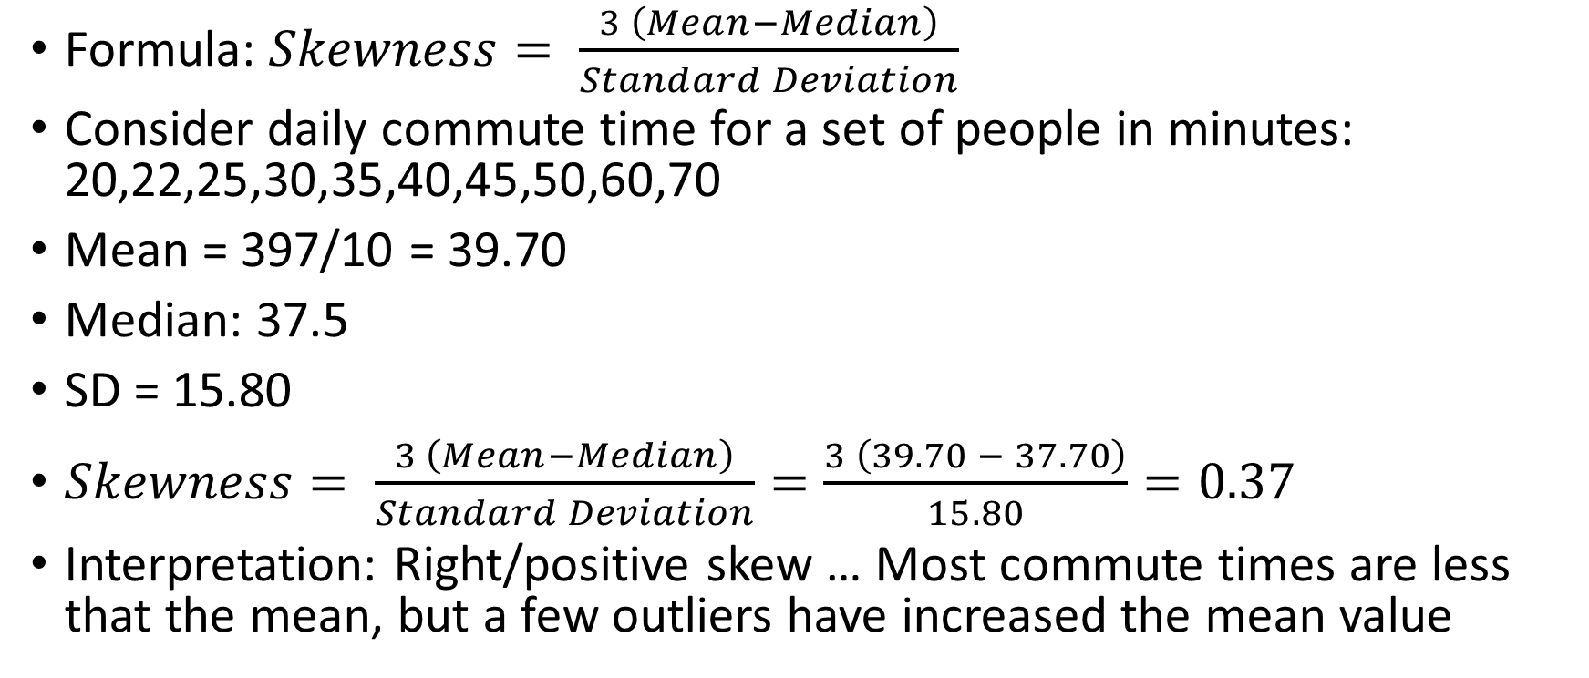
Pearson’s Coefficient of Skewness
Formula: $Skewness= \frac{3 \left(Mean−Median\right)}{Standard Deviation}$
Consider daily commute time for a set of people in minutes: 20,22,25,30,35,40,45,50,60,70
Mean = 397/10 = 39.70
Median: 37.5
SD = 15.80
$Skewness= \frac{3 \left(Mean−Median\right)}{Standard Deviation}=\frac{3 \left(39.70 − 37.70\right)}{15.80}=0.37$
Interpretation: Right/positive skew … Most commute times are less that the mean, but a few outliers have increased the mean value

